Slide 1
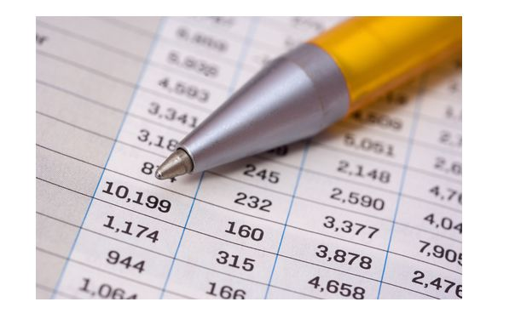
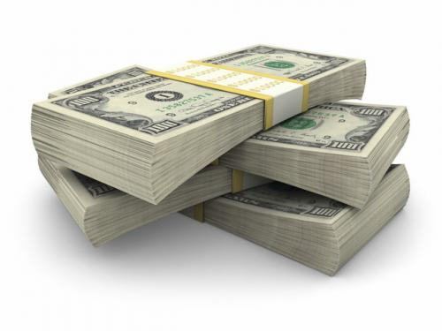
Engineering Economy
Lecture 3
Text Book:
Engineering Economy- Sullivan, Bontadelli, Wicks, 11th Ed.
Pearson Education
Lecture 3 from Chapter 3
Lecture 4 (Project Selection) from Chapter 4

Slide 2
Outline
By the end of this lecture you will be able to:
Explain the concept of Time Value of Money
Develop the concept of simple and compound interest
Develop the concept about Future Value and Present Value of money/ asset
Calculate present and future value of money/asset

Slide 3
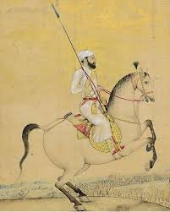
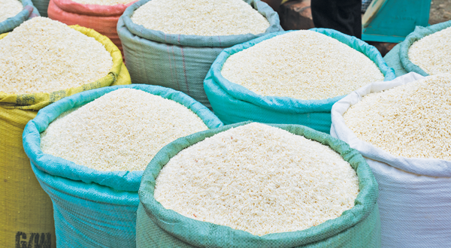

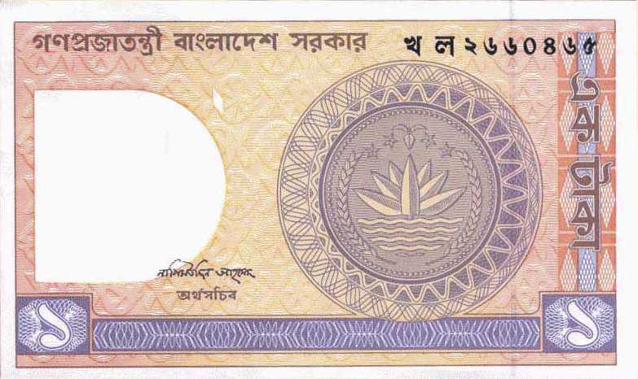
Time Value of Money

Slide 4
The Time Value of Money
The initial amount of money invested or borrowed in transactions is called the principal (P).
The interest rate (i) measures the cost or price of money and is expressed as a percentage per period of time.
A specified length of time marks the duration of the transaction and thereby establishes a certain number of interest periods (N).
A future amount of money (F) results from the cumulative effects of the interest rate over a number of interest periods.

Slide 5
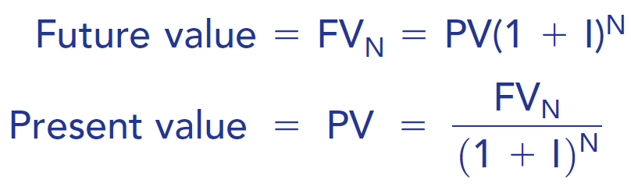
Effect of market interest rate

Slide 6
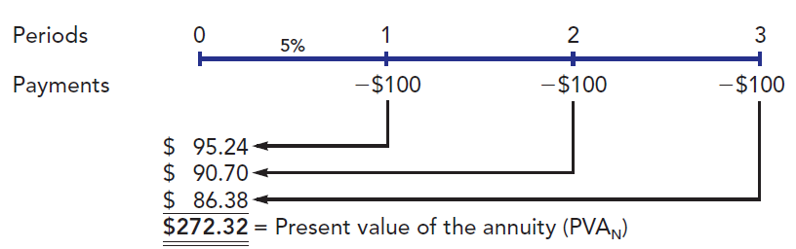
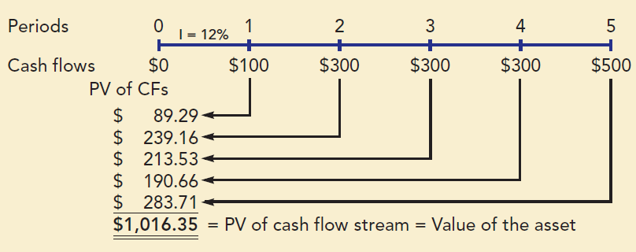
Finding the Present Value : Examples
Example 1 : Find the present value of the annuity at 5% interest rate.
Example 2: Find the present value of the asset whose cash flow is shown below (consider 12% interest rate).

Slide 7
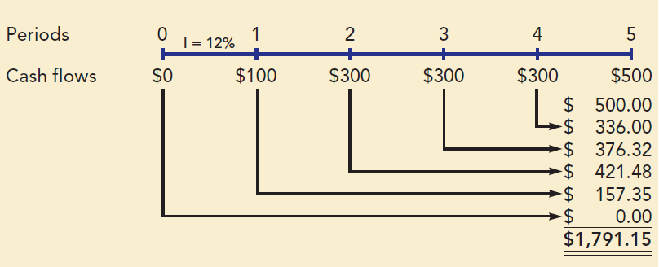
Finding the Future Value : Examples
Example 3 Find the Future Worth of the cash flows at 5th year at 12% interest rate.

Slide 8
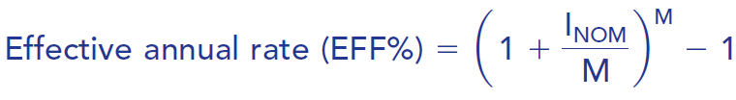
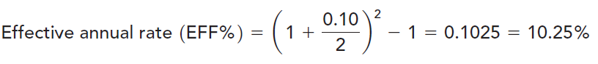
How would things change in our example if interest were compounded quarterly, or monthly, or daily?
Here I_{NOM} is the nominal rate expressed as a decimal and M is the number of compounding periods per year. For example, the nominal rate is 10 percent but with semiannual compounding, hence

Slide 9
Example 4: Would you rather invest in an account that pays 7 percent with annual compounding or 7 percent with monthly compounding? Would you rather borrow at 7 percent and make annual or monthly payments? Why?
Example 5: What’s the future value of $100 after three years if the appropriate interest rate is 8 percent, compounded annually? Compounded monthly?
(Ans.: $125.97; $127.02)
Example 6: What’s the present value of $100 due in three years if the appropriate interest rate is 8 percent, compounded annually? Compounded monthly?
(Ans. $79.38; $78.73)

Slide 10
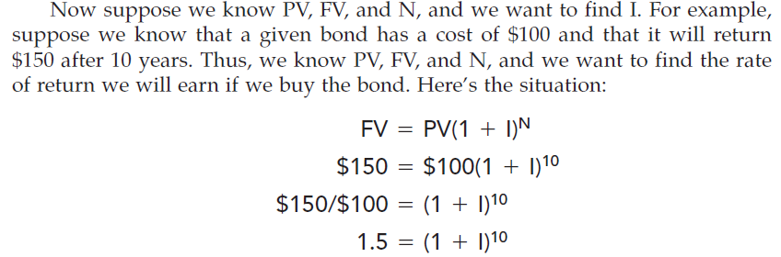
Finding The Interest Rate
Example 7:
Ans: I = 4.14%

Slide 11


